Slide 1
Data Structure
Stack

Slide 2
Stack data structure
Stack data structure is like a container with a single opening.
Can only access element at the top
Add/insert new items at the top
Remove/delete an item from the top
Stack in real life:
collection of elements arranged in a linear order.
- stack of books, stack of plates, stack of chairs.

Slide 3
Stack
push
pop
A stack is open at one end (the top) only. You can push entry onto the top, or pop the top entry out of the stack.
Note that you cannot add/extract entry in the middle of the stack.
top
C
B
A
bottom

Slide 4
Last-in First-out (LIFO)
A
B
C
C
Insert(A);
Insert(B);
Insert(C);
Remove();
Remove();
Remove();
The last one inserted in is the first one removed out! (LIFO)
B
C
B
A
A
A
A
B
C
When we insert entries onto the stack and then remove them out one by one, we will get the entries in reverse order.
B
A
A

Slide 5
Stack
A stack or LIFO (last in, first out) is an abstract data type that serves as a collection of elements, with two principal operations:
Push: adds an element to the collection;
Pop: removes the last (top of the stack) element that was added.
Bounded capacity
If the stack is full and does not contain enough space to accept an entity to be pushed, the stack is then considered to be in an overflow state.
A pop either reveals previously concealed items or results in an empty stack – which means no items are present in stack to be removed.
Non-Bounded capacity
Dynamically allocate memory for stack. No overflow.

Slide 6
Abstract Data Type (ADT)
An abstract data type is a type with associated operations, but whose representation is hidden.
The basic idea is that the implementation of these operations is written once in the program, and any other part of the program that needs to perform an operation on the ADT can do so by calling the appropriate function.
If for some reason implementation details need to change, it should be easy to do so by merely changing the routines that perform the ADT operations. This change, in a perfect world, would be completely transparent to the rest of the program.

Slide 7
Abstract Data Type (ADT)
A data type whose properties (domain and operations) are specified independently of any particular implementation.
ADT is a mathematical model which gives a set of utilities available to the user but never states the details of its implementation.
In OO-Programming a Class is an ADT.

Slide 8

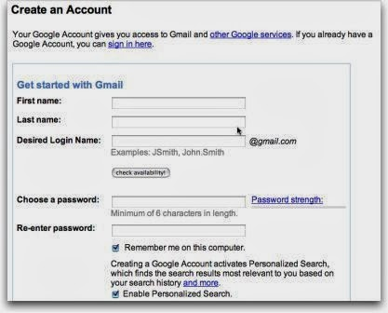
Let us consider Gmail.
We can do lot of operation with Gmail such as Create Account, Sign in, Compose, Send, etc.,
We know the required details to Create an account.

Slide 9
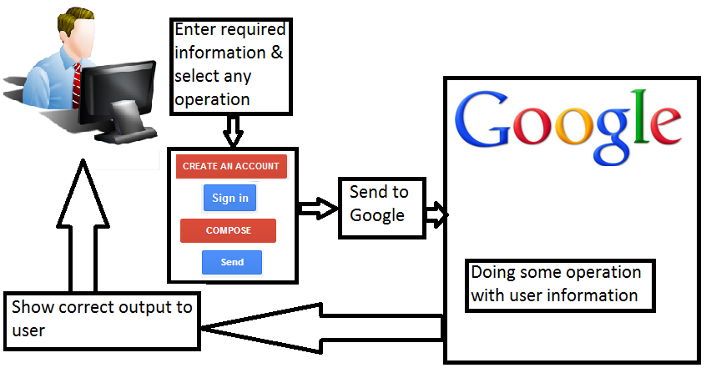
But we don't know how these operations are functioning in background.
We don't know how Google team handling these operation to give you the required output.
Implementation of operation is always hidden to the user.

Slide 10
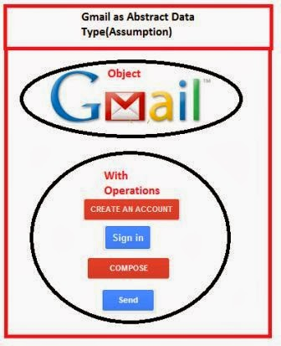
Let us assume Gmail as abstract data type. We can say Gmail is an object with operations such as create account, sign in, compose, send, etc.,

Slide 11
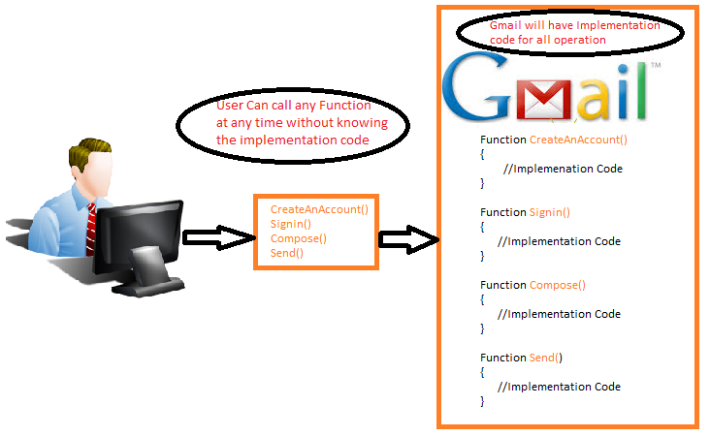
Abstract Data Type:

Slide 12
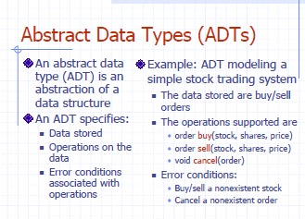

Slide 13
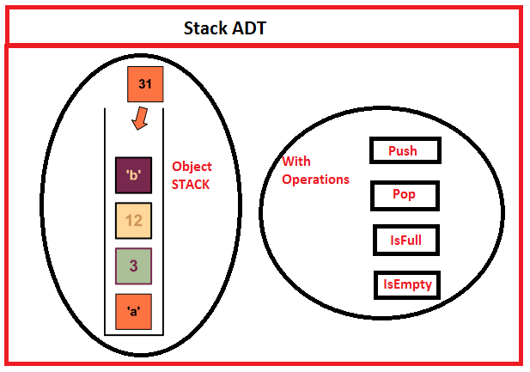

Slide 14
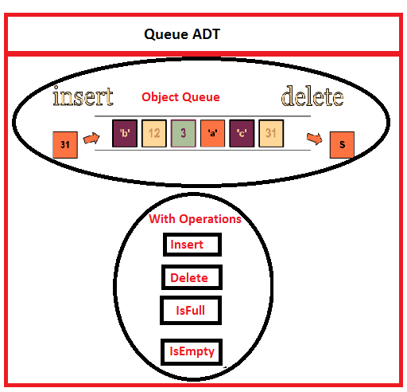

Slide 15
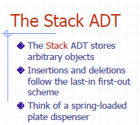

Slide 16
Stack Operations
Push(X) – insert element X at the top of the stack and increment the top index.
Pop() – remove the element from the top of the stack with/without returning element and decrement the top index.
Top() – return the top element without removing it from the stack. top index does not change.

Slide 17
stack implementation by an array
#define stack_size 6;
int top;
char stack[stack_size];
?
5 (stacksize-1)
?
4
?
3
?
2
?
1
?
0
stack
top = 2
stack

Slide 18
Initialization of top index of Stack
stack_initialize()
{
top = -1;
}
?
5 (stacksize-1)
?
4
?
3
?
2
?
1
?
0
top
E--1ntry
top = 0

Slide 19
Push(X)
Before insertion it needs first to check the overflow situation i.e. stack is full or not full
void push(char X)
{
if(top >= stack_size-1)
cout<<“Overflow: stack is full”;
else
{
top++; /increase top by 1
stack[top] = X; /insert the item on top
}
}
?
5 (stacksize-1)
?
4
?
3
?
2
?
1
top= 0 →1
top
X
0
entry
top++;
stack[top] = X;
Stack[++top] = X;

Slide 20
Pop()
void pop() //pop function is not returning
{
if(top<0)
cout<<"underflow: stack is empty”;
else
{
char X = stack[top];
top--;
}
}
Before deletion it needs first to check the underflow situation i.e. stack is empty or not empty
?
5
?
4
?
3
?
2
?
1
?
0
top
E--1ntry
entry
top= 1→0
char X = stack[top];
top--;
char X = stack[top--];

Slide 21
Pop() //pop function is returning the top element
char pop()
{
if(top<0)
cout<<"underflow: stack is empty”;
else
{
char X = stack[top];
top--;
return X;
}
}
?
5
?
4
?
3
?
2
?
1
?
0
top
E--1ntry
entry
top= 1→0

Slide 22
Top()
char Top() //top function is returning top value
{
return stack[top]; //but not reduce top index
}
?
5
?
4
?
3
?
2
top= 1→0
top
R
1
K
0
entry

Slide 23
Other operations
int IsEmpty()
{
return ( top < 0 );
}
int IsFull()
{
return ( top >= stack_size-1);
}
?
5 (stacksize-1)
?
4
?
3
?
2
?
1
?
0
stack
top = 2

Slide 24
// ……Program for stack implementation
#include <iostream>
using namespace std;
// here add all the initializations and
//functions’ definitions of stack.
int main()
{
push(9);
push(7);
push (8);
push (4);
pop ( );
push (5);
pop ( );
pop ( );
cout<< " top element of stack is = " << top() << endl;
cout << " top index is = " << top << endl;
}
?
5 (stacksize-1)
?
4
4
3
8
2
7
1
9
0
stack
top = 2

Slide 25
// ……Program for stack implementation
#include <iostream>
using namespace std;
// here add all the initializations and
//functions’ definitions of stack.
int main()
{
push(9);
push(7);
push (8);
push (4);
pop ( );
push (5);
pop ( );
pop ( );
cout<< " top element of stack is = " << top() << endl;
bout << " top index is = " << top << endl;
}
?
5 (stacksize-1)
?
4
?
3
8
2
7
1
9
0
stack
top = 2

Slide 26
// ……Program for stack implementation
#include <iostream>
using namespace std;
// here add all the initializations and
//functions’ definitions of stack.
int main()
{
push(9);
push(7);
push (8);
push (4);
pop ( );
push (5);
pop ( );
pop ( );
cout<< " top element of stack is = " << top() << endl;
bout << " top index is = " << top << endl;
}
?
5 (stacksize-1)
?
4
5
3
8
2
7
1
9
0
stack
top = 2

Slide 27
// ……Program for stack implementation
#include <iostream>
using namespace std;
// here add all the initializations and
//functions’ definitions of stack.
int main()
{
push(9);
push(7);
push (8);
push (4);
pop ( );
push (5);
pop ( );
pop ( );
cout<< " top element of stack is = " << top() << endl;
bout << " top index is = " << top << endl;
}
?
5 (stacksize-1)
?
4
3
2
7
1
9
0
stack
top = 2
top element of stack is = 7
top index is = 1

Slide 28
Traversing a stack
void show()
{
int i;
for(i=top; i>=0; i--)
cout<< “ “<<stack[i];
}
OUTPUT:
D C B A
?
?
top
D
3
C
2
B
1
A
0
Stack[ ]

Slide 29
Stack
int Stack[100], Top=-1; // Stack holds the elements;
// Top is the index of Stack always pointing to the first/top element of the stack.
bool IsEmpty( void ); // returns True if stack has no element
bool IsFull( void ); // returns True if stack full
bool Push( int Element ); // inserts Element at the top of the stack
bool Pop( int *Element ); // deletes top element from stack into Element
bool TopElement( int *Element ); // gives the top element in Element
void Show( void ); // prints the whole stack

Slide 30
bool IsEmpty( void ){
// returns True if stack has no element
return (Top < 0);
}
6
5
4
3
2
1
0
Considering Size = 7
Top

Slide 31
bool IsFull( void ){
// returns True if stack full
return ( Top >= Size-1 );
}
6 | G
5 | F
4 | E
3 | D
2 | C
1 | B
0 | A
Considering Size = 7
Top

Slide 32
bool Push( int Element ){
// inserts Element at the top of the stack
if( IsFull( ) )
{ cout << "Stack is Full\n"; return false; }
// push element if there is space
Stack[ ++Top ] = Element;
return true;
}
6
5
4
3
2 | C
1 | B
0 | A
Considering Size = 7
There are 3 elements inside Stack
So next element will be pushed at index 3
Top

Slide 33
bool Pop( int *Element ){
// deletes top element from stack and puts it in Element
if( IsEmpty() )
{ cout << "Stack empty\n"; return false; }
*Element = Stack[ Top-- ];
return true;
}
6
5
4
3 | D
2 | C
1 | B
0 | A
Considering Size = 7
There are 4 elements inside Stack
So element will be popped from index 3
Top

Slide 34
bool TopElement( int *Element ){
// gives the top element in Element
if( IsEmpty() )
{ cout << "Stack empty\n"; return false; }
*Element = Stack[ Top ];
return true;
}
6
5
4
3 | D
2 | C
1 | B
0 | A
Considering Size = 7
There are 4 elements inside Stack
So top element will be at index 3
Top

Slide 35
void Show( void ){
// prints the whole stack
if( IsEmpty() )
{ cout << "Stack empty\n"; return; }
for( int i=Top; i>=0; i-- ) cout << Stack[i] <<endl;
}
6
5
4
3 | D
2 | C
1 | B
0 | A
Considering Size = 7
There are 4 elements inside Stack
So element will be shown from index 3 down to index 0.
Top

Slide 36
Creating a class for Stack
class MyStack{
int Stack[MaxSize], Top, MaxSize=100;
public:
//Initializing stack
MyStack( int Size = 100 ){ MaxSize = Size; Top = -1;}
bool IsEmpty( void );
bool IsFull( void );
bool Push( int Element );
bool Pop( int &Element );
bool TopElement( int &Element );
void Show( void );
void Reset( void ){ Top = -1; } //Re-start the stack
};

Slide 37
// ……Program for stack implementation using stack class
#include <iostream>
#include <stack>
using namespace std;
int main()
{ stack <int> st;
st.push(9);
st.push(7);
st.push (8);
st.push (9);
st.pop ( );
st.push (5);
st.pop ( );
st.pop ( );
cout<< " top element of stack is = " << st.top() << endl;
cout << " top index is = " << st.size()-1 << endl;
}
top element of stack is = 7
top index is = 1

Slide 38
Stack Using Dynamic Memory Allocation
class MyStack{
int *Stack, Top, MaxSize=100;
public:
MyStack( int );
~MyStack( void );
bool IsEmpty( void );
bool IsFull( void );
bool Push( int );
bool Pop( int & );
bool TopElement( int & );
void Show( void );
void Reset( void ){ Top = -1; }
void Resize( int ); //Resize the stack
};

Slide 39
The Constructor will create the array dynamically, Destructor will release it.
MyStack::MyStack( int Size ){
MaxSize = Size; // get Size
Stack = new int[ MaxSize ]; // create array acordingly
Top = 0; // start the stack
}
MyStack::~MyStack( void ){
delete [] Stack; // release the memory for stack
}

Slide 40
Resize creates a new array dynamically, copies all the element from the previous stack, releases the old array, and makes the pointer Stack point to the new array.
User can define the additional size. Use negative size to decrease the array.
void Resize( int Size ){
// creates a new stack with MaxSize + Size
int *S = new int[ MaxSize + Size ];
// copy the elements from old to new stack
for( int i=0; i<MaxSize; i++ ) S[i] = Stack[i];
MaxSize += Size; // MaxSize increases by Size
delete [] Stack; // release the old stack
this.Stack = S; // assign Stack with new stack.
}

Slide 41
void Push( int Element ){
// inserts Element at the top of the stack
if( StackFull( ) ) Resize( 5 ); // increase size if full
Stack[ ++Top ] = Element;
}

Slide 42
Generic Stack
template <typename T>
class MyStack{
T *Stack;
int Top, MaxSize;
public:
MyStack( int );
~MyStack( void );
bool IsEmpty( void );
bool IsFull( void );
bool Push( const T );
bool Pop( T & );
bool TopElement( T & );
void Show( void );
void Reset( void ){ Top = 0; }
void Resize( int ); //Resize the stack
};

Slide 43
// ……Program for stack implementation using stack class (ADT)
#include <iostream>
#include <stack>
using namespace std;
int main()
{ stack <int> st;
st.push(9);
st.push(7);
st.push (8);
st.push (9);
st.pop ( );
st.push (5);
st.pop ( );
st.pop ( );
cout<< " top element of stack is = " << st.top() << endl;
cout << " top index is = " << st.size()-1 << endl;
}
top element of stack is = 7
top index is = 1

Slide 44
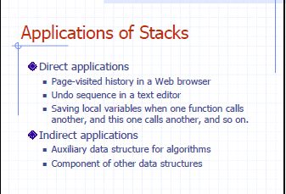

Slide 45
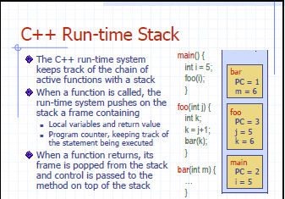

Slide 46
Application of stack continuation……
Syntax parsing, Expression evaluation and Expression conversion.
Banking Transaction View
- You view the last transaction first.
Backtracking and implementation of recursive function, calling function.
Towers of Hanoi

Slide 47
Validity checking of an arithmetic expression
When there is a opening parenthesis; brace or bracket, there should be the corresponding closing parenthesis. Otherwise, the expression is not a valid one. We can check this validity using stack.

Slide 48
Stack in Problem Solving
Consider a mathematical expression that includes several sets of nested parenthesis, e.g
( x + (y – (a +b)) )
We want to ensure that parenthesis are nested correctly and the expression is valid
Validation
There is an equal number of closing and opening parentheses
Every closing parenthesis is preceded by a matching opening parenthesis

Slide 49
Algorithm
Whenever an opening is encountered, PUSH() on to stack
Whenever a closing is encountered,
If stack is empty, expression is invalid.
If stack is nonempty, POP() the stack and check with corresponding closing parenthesis. If match occurs continue. Otherwise expression is invalid.
When the end of expression is reached, stack must be empty; otherwise expression invalid.

Slide 50
Example: [(A+B)-{(C+D)-E}]
Symbol | Stack
[ | [
( | [(
A | [(
+ | [(
B | [(
) | [
- | [
{ | [{
( | [{(
C | [{(
+ | [{(
D | [{(
) | [{
- | [{
E | [{
} | [
]

Slide 51
Algebraic Expression
An algebraic expression is a legal combination of operands and the operators.
Operand is the quantity (unit of data) on which a mathematical operation is performed.
Operand may be a variable like x, y, z or a constant like 5, 4,0,9,1 etc.
Operator is a symbol which signifies a mathematical or logical operation between the operands. Example of familiar operators include +,-,*, /, ^ , %
Considering these definitions of operands and operators now we can write an example of expression as
x+y*z

Slide 52
Infix, Postfix and Prefix Expressions
INFIX: From our schools times we have been familiar with the expressions in which operands surround the operator, e.g. x+y, 6*3 etc this way of writing the Expressions is called infix notation.
POSTFIX: Postfix notation are also Known as Reverse Polish Notation (RPN). They are different from the infix and prefix notations in the sense that in the postfix notation, operator comes after the operands, e.g. xy+, xyz+* etc.
PREFIX: Prefix notation also Known as Polish notation. In the prefix notation, as the name only suggests, operator comes before the operands, e.g. +xy, *+xyz etc.

Slide 53
Operator Priorities
How do you figure out the operands of an operator?
a + b * c
a * b + c / d
This is done by assigning operator priorities.
priority(*) = priority(/) > priority(+) = priority(-)
When an operand lies between two operators, the operand associates with the operator that has higher priority.

Slide 54
Tie Breaker
When an operand lies between two operators that have the same priority, the operand associates with the operator on the left.
a * b / c / d
Delimiters
Sub expression within delimiters is treated as a single operand, independent from the remainder of the expression.
(a + b) * (c – d) / (e – f)

Slide 55
WHY PREFIX and POSTFIX ?
Why to use these weird looking PREFIX and POSTFIX notations when we have simple INFIX notation?

Slide 56
Infix
To our surprise INFIX notations are not as simple as they seem specially while evaluating them. To evaluate an infix expression we need to consider Operators’ Precedence and Associative property
For example expression 3+5*4 evaluate to
32 = (3+5)*4 or
23 = 3+(5*4)
Operator precedence and associativity governs the evaluation order of an expression.
An operator with higher precedence is applied before an operator with lower precedence.
Same precedence order operator is evaluated according to their associativity order.

Slide 57
Operator Precedence and Associativity
Precedence | Operator | Associativity
1 | :: | Left-to-right
2 | () [] . -> ++ -- | Left-to-right
3 | ++ -- ~ ! sizeof new delete | Right-to-left
 | * &
 | + -
4 | (type) | Right-to-left
5 | .* ->* | Left-to-right
6 | * / % | Left-to-right
7 | + - | Left-to-right
8 | << >> | Left-to-right
Precedence | Operator | Associativity
9 | < > <= >= | Left-to-right
10 | == != | Left-to-right
11 | & | Left-to-right
12 | ^ | Left-to-right
13 | | | Left-to-right
14 | && | Left-to-right
15 | || | Left-to-right
16 | ?: | Right-to-left
17 | = *= /= %= += -= >>= <<= &= ^= |= | Right-to-left
18 | , | Left-to-right

Slide 58
What is associativity (for an operator) and why is it important?
For operators, associativity means that when the same operator appears in a row, then which operator occurrence we apply first.
It's important, since it changes the meaning of an expression. Consider the division operator with integer arithmetic, which is left associative
4 / 2 / 3 <=> (4 / 2) / 3 <=> 2 / 3 = 0
If it were right associative, it would evaluate to an undefined expression, since you would divide by zero
4 / 2 / 3 <=> 4 / (2 / 3) <=> 4 / 0 = undefined

Slide 59
Infix Expression Is Hard To Parse
Need operator priorities, tie breaker, and delimiters.
This makes computer evaluation more difficult than is necessary.
Postfix and prefix expression forms do not rely on operator priorities, a tie breaker, or delimiters.
So it is easier to evaluate expressions that are in these forms.

Slide 60
Both prefix and postfix notations have an advantage over infix that while evaluating an expression in prefix or postfix form we need not consider the Priority and Associative property (order of brackets).
E.g. x/y*z becomes
*/xyz in prefix and
xy/z* in postfix.
Both prefix and postfix notations make Expression Evaluation a lot easier.

Slide 61
When do we need to use them… ☺
So, what is actually done in expression is scanned from user in infix form; it is converted into prefix or postfix form and then evaluated without considering the parenthesis and priority of the operators.

Slide 62
Differences between Infix, Postfix and Prefix
Infix notation is easy to read for humans, whereas pre-/postfix notation is easier to parse for a machine.
The big advantage in pre-/postfix notation is that there never arise any questions like operator precedence.

Slide 63
Differences between Infix, Postfix and Prefix
Infix is more human-readable. That's why it is very commonly used in mathematics books.
Infix has to add more information to remove ambiguity. So, for example, we use parenthesis to give preference to lower precedence operator.
Postfix and Prefix are more machine-readable. So for instance, in postfix, every time you encounter a number, put it on a stack, every time you encounter an operator, pop the last two elements from the stack, apply the operation and push the result back.

Slide 64
Examples of infix to prefix and postfix
Infix | PostFix | Prefix
A+B | AB+ | +AB
(A+B) * (C + D) | AB+CD+* | *+AB+CD
A-B/(C*D^E) | ABCDE^*/- | -A/B*C^DE
A
-
B
/
(
C
*
D
^
E
)
A
B
C
D
E
^
*
/
-
-
A
/
B
*
C
^
D
E
A
-
B
/
(
C
*
F
)
A
B
C
F
*
/
-
D
^
E
-
A
/
B
*
C
F
D
^
E
A
-
B
/
G
A
B
G
/
-
C
*
F
-
A
/
B
G
C
*
F
A
-
H
A
H
-
B
/
G
-
A
H
B
/
G
I
I
A
-
H
I
A
-
H

Slide 65
Algorithm for Infix to Postfix conversion
1) Examine the i^{th} element in the input, infix[i].
2) If it is operand, output it at k^{th} location (push to postfix[k]).
3) else If it is opening parenthesis ‘(’, push it on stack.
4) else If it is a closing parenthesis ‘)’,
pop (operators) from stack and output to postfix[k] them until an opening parenthesis ‘(’ is encountered in the top of stack.
pop and discard the opening parenthesis ‘(’ from stack.
5) else If it is an operator ‘+’, ‘-’, ‘*’, ‘/’, ‘%’ then
i) If stack is empty, push operator on stack.
ii) else If the top of stack is opening parenthesis ‘(’, push on stack
iii) else If it has higher priority than the top of stack, push on stack.
iv) else pop the operator from the stack and output it, repeat step 5
6) If there is more input in infix[], go to step 1
7) If there is no more input, pop the remaining operators to output.

Slide 66
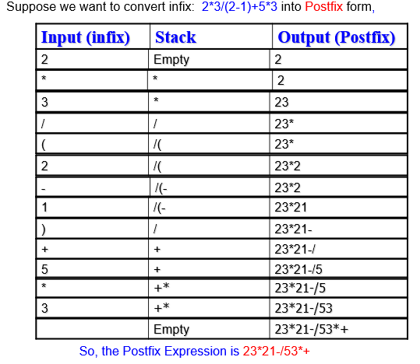

Slide 67
Suppose we want to convert infix: 2*3/(2-1)+5*3 into Postfix form,
Input (infix) | Stack | Output (Postfix)
2 | Empty | 2
* | * | 2
3 | * | 23
/ | / | 23*
( | /( | 23*
2 | /( | 23*2
- | /(- | 23*2
1 | /(- | 23*21
) | / | 23*21-
+ | + | 23*21-/
5 | + | 23*21-/5
* | +* | 23*21-/5
3 | +* | 23*21-/53
 | Empty | 23*21-/53*+
So, the Postfix Expression is 23*21-/53*+

Slide 68
Converting Infix to Postfix
Infix Expression: 2*6/(4-1)+5*3
Add ')' to the end of Infix; Push( '(' );
do{
OP = next symbol from left of Infix;
if OP is OPERAND then EnQueue( OP );
else if OP is OPERATOR then{
if OP = '(' then Push( OP );
else if OP = ')' then{
Pop( StackOperator );
while StackOperator != '(' do{
Enqueue( Stackoperator );
Pop( StackOperator );
}`
}else{
while Precedence( OP ) <= Precedence( TopElement( ) ) do{
Pop( StackOperator );
Enqueue( StackOperator );
}
Push( OP );
}
}while !IsEmpty( );
)
+
2
4
-
)
+
2
4
-
1
/
1
/
)
Infix
*
6
(
5
*
3
)
*
6
(
5
*
3
Postfix
2
6
*
4
1
-
/
5
3
*
+
Stack
(
+
*
/
(
*
-
OPERATOR
OPERAND
End of Expression
* ≥ StackTop( + )
push (-) to stack
/ = StackTop( * )
Push (*) to stack
Push (/) to stack
(
)
+ < StackTop( / )
Push (+) to stack

Slide 69
Example
( 5 + 6) * 9 +3
will be
5 6 + 9 * 3 +
Conversion of infix to prefix??

Slide 70
Algorithm for Infix to Postfix conversion
1) Examine the i^{th} element in the input, infix[i].
2) If it is operand, output it at k^{th} location (push to postfix[k]).
3) else If it is opening parenthesis ‘(’, push it on stack.
4) else If it is a closing parenthesis ‘)’,
pop (operators) from stack and output to postfix[k] them until an opening parenthesis ‘(’ is encountered in the top of stack.
pop and discard the opening parenthesis ‘(’ from stack.
5) else If it is an operator ‘+’, ‘-’, ‘*’, ‘/’, ‘%’ then
i) If stack is empty, push operator on stack.
ii) else If the top of stack is opening parenthesis ‘(’, push on stack
iii) else If it has higher priority than the top of stack, push on stack.
iv) else pop the operator from the stack and output it, repeat step 5
6) If there is more input in infix[], go to step 1
7) If there is no more input, pop the remaining operators to output.

Slide 71
Infix to Prefix conversion
Input | Output_stack | Stack
) | EMPTY | )
G | G | )
+ | G | )+
F | GF | )+
( | GF+ | EMPTY
- | GF+ | -
) | GF+ | -)
) | GF+ | -))
E | GF+E | -))
+ | GF+E | -))+
D | GF+ED | -))+
( | GF+ED+ | -)
* | GF+ED+ | -)*
C | GF+ED+C | -)*
+ | GF+ED+C* | -)+
) | GF+ED+C* | -)+)
B | GF+ED+C*B | -)+)
- | GF+ED+C*B | -)+)-
A | GF+ED+C*BA | -)+)-
( | GF+ED+C*BA- | -)+
( | GF+ED+C*BA-+ | -
EMPTY | GF+ED+C*BA-+- | EMPTY
We have infix expression in the form of:
((A-B)+C*(D+E))-(F+G)
Now reading expression from right to left and
pushing operators into stack and variables to
output stack.
Out put_stack = GF+ED+C*BA-+-
Reversing the output_stack we get
prefix expression: -+-AB*C+DE+FG

Slide 72
Evaluating Postfix Notation
Use a stack to evaluate an expression in postfix notation.
The postfix expression to be evaluated is scanned from left to right.
Variables or constants are pushed onto the stack.
When an operator is encountered, the indicated action is performed using the top elements of the stack, and the result replaces the operands on the stack.

Slide 73
Algorithm: To evaluate a postfix value
Add “)” at the right end of the expression. (this is just to know when to stop)
Scan p from left to right and repeat step 3 and 4 for each element of p until encountered “)”.
If an operand is encountered, PUSH it in stack.
If an operator  is encountered, then
To remove two element from stack Call POP() twice and first POP() put to A and second one to B.
Evaluate C = B  A.
PUSH(C) in stack.
Set the value = POP(), the top element of stack.
Exit

Slide 74
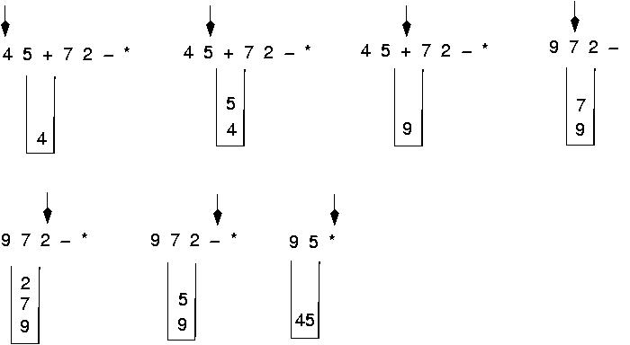
Postfix expressions: Algorithm using stacks (cont.)

Slide 75
Question : Evaluate the following expression in postfix : 623+-382/+*2^3+
Final answer is ?

Slide 76
Evaluate- 623+-382/+*2^3+ )
6
2
6
3
2
6
623+-382/+*2^3+)
65-382/+*2^3+) 1382/+*2^3+)
5
6
1
3
1
8
3
1
2
8
3
1
4
3
1

Slide 77
Cont. of Evaluation- 623+-382/+*2^3+
134+*2^3+)
72^3+) 493+) )
= 52
4
3
1
7
1
7
2
7
49
3
49
52

Slide 79
Evaluating Postfix Expression
6
6
*
*
4
4
1
1
-
-
/
/
5
5
3
3
*
*
+
+
)
2
)
Postfix
2
Postfix Expression: 26*41-/53*+
EnQueue( ')' );
while ( FrontElement( ) != ')' ){
DeQueue( OP );
if OP is OPERAND then Push( OP );
else if OP is OPERATOR then{
Pop( OperandRight );
Pop( OperandLeft );
Push( Evaluate( OperandLeft, OP, OperandRight ) );
}
}
Pop( Result );
cout << Result;
}
Stack
2
6
1
12
4
19
4
3
5
15
3
OPERATOR
OPERAND
Evaluate( 2, '*', 6 ) = 12
Evaluate( 4, '+', 15 ) = 19
‘)‘
Evaluate( 5, '*', 3 ) = 15
Evaluate( 12, '/', 3 ) = 4
Evaluate( 4, '-', 1 ) = 3
End of Expression
Expression Result = 19

Slide 80
Algorithm: To evaluate a prefix value
Add “(” at the left end of the expression.
Scan p from right to left and repeat step 3 and 4 for each element of p until encountered “(”.
If an operand is encountered, PUSH it in stack.
If an operator  is encountered, then
To remove two element from stack Call POP() twice and first POP() put to A and second one to B.
Evaluate C = A  B
PUSH(C) in stack.
Set the value = POP(), the top element of stack.
Exit

Slide 83
Abstract Meaning:
* Existing in thought or as an idea but not having a physical or concrete existence.
* Consider something theoretically or separately from (something else).
* A summary of the contents of a book, article, or speech.

